Slide 1


博弈论及其在物联网中的应用
面向语义的短文本分类的研究
徐 佳
xujia@njupt.edu.cn
江苏省大数据安全与智能处理重点实验室

Slide 2
Outline
Introduction
Static Game
Auction
Three Topics

Slide 3
1. Introduction

Slide 4
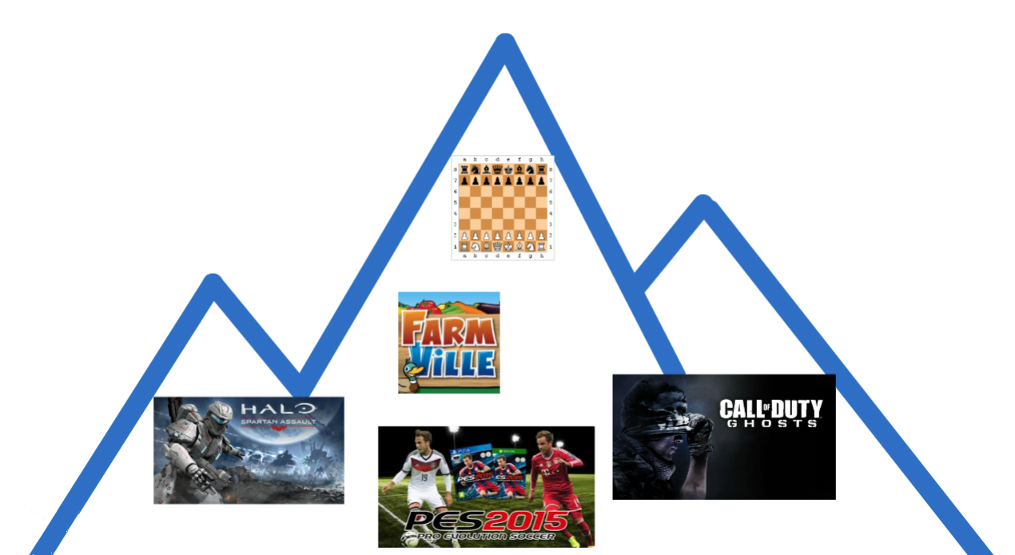
What is Game Theory?

Slide 5
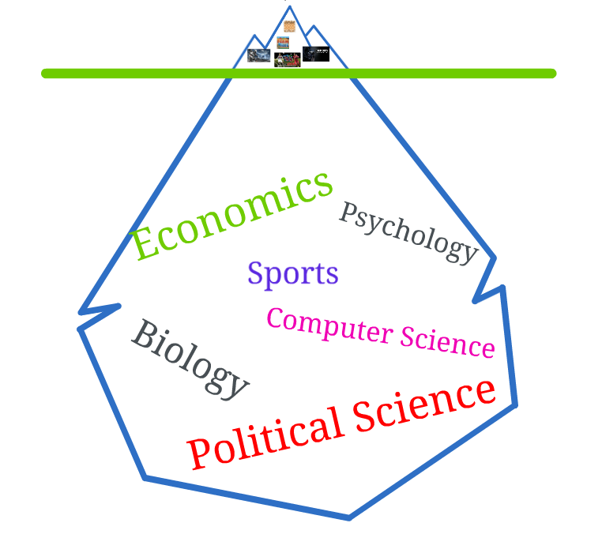

Slide 6
What is The Game Theory?
Game theory is the study of how rational decision-makers make decisions.
Different from operational research
Competition and Cooperation
Game Theory for Everything
Human-centered World
Artificial Intelligence World

Slide 7
What is Game?
Player: A decision-maker
Strategy: An action of taken by the player
Utility/Payoff: Player’s valuation on the outcome
Example: Chess, WiFi Network Connection

Slide 8
2. Static Game
面向语义的短文本分类的研究

Slide 9
Outline
Prisoner’s Dilemma
Dominant Strategy and Dominated Strategy

Slide 10


Slide 11
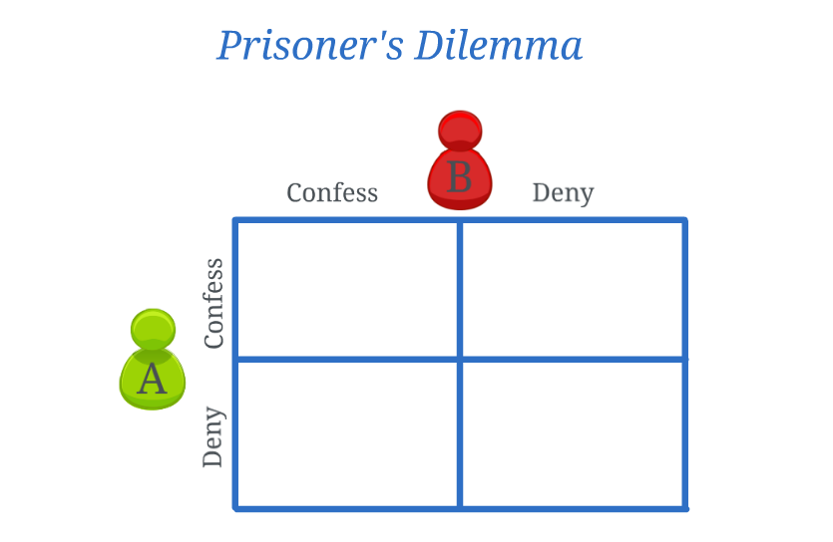
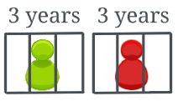


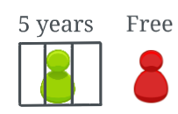
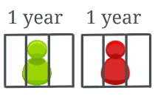
Prisoner’s Dilemma

Slide 12
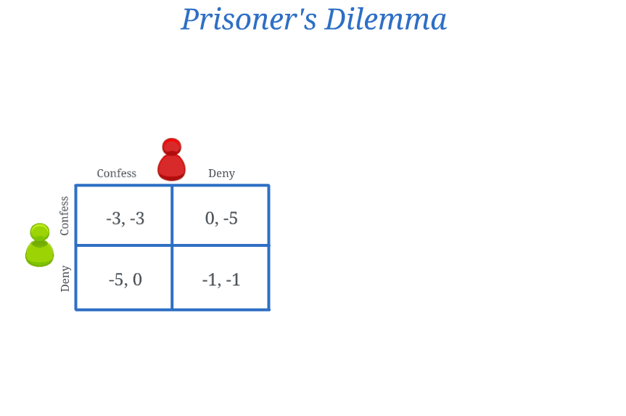
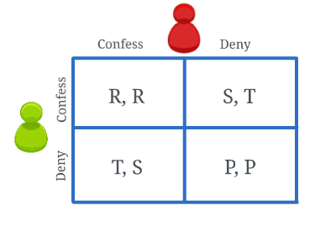

Prisoner’s Dilemma
General Form

Slide 13
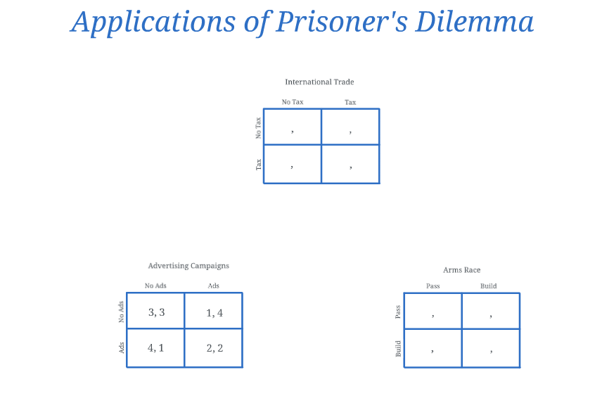
Prisoner’s Dilemma

Slide 14
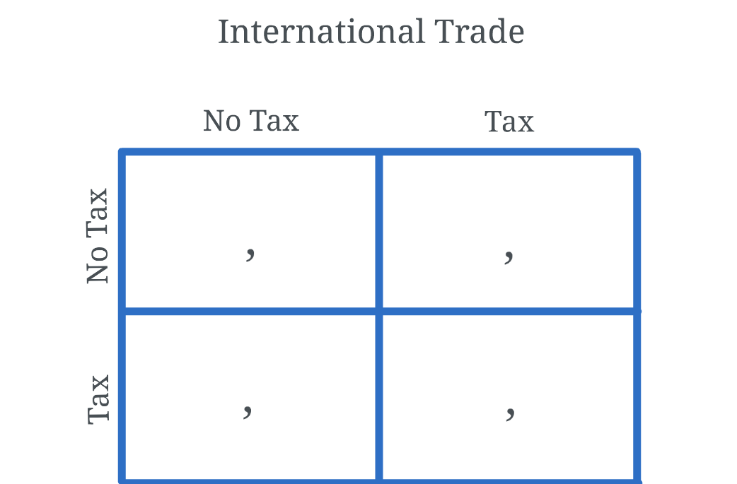




Prisoner’s Dilemma

Slide 15
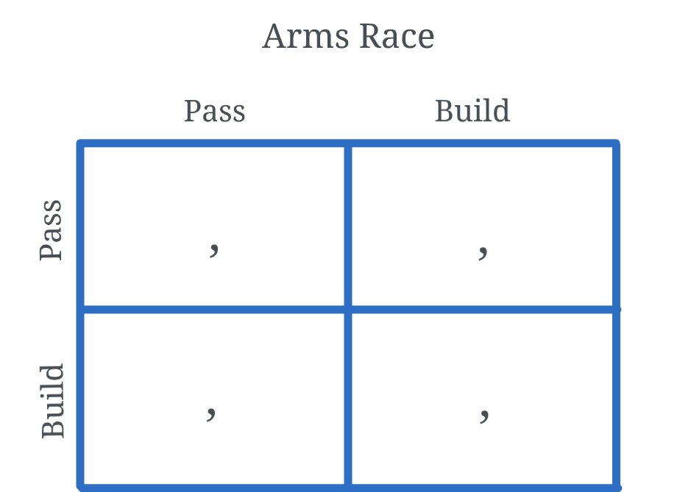




Prisoner’s Dilemma

Slide 16
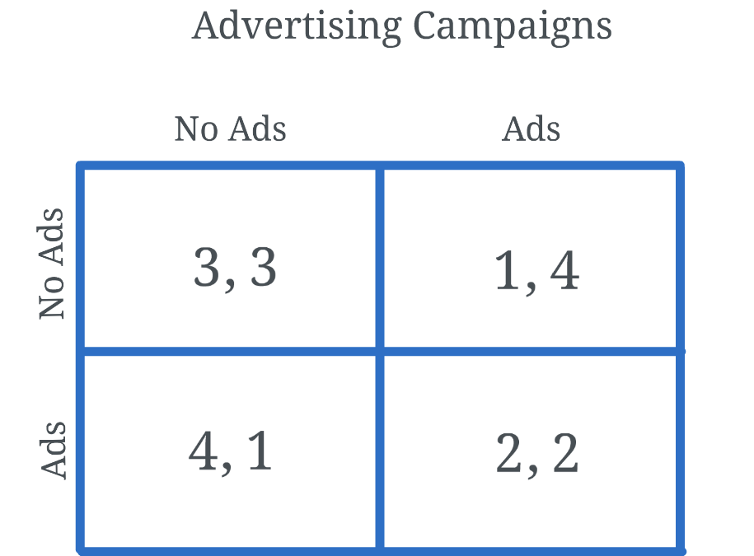
Prisoner’s Dilemma

Slide 17
Dominant Strategy and Dominated Strategy
Dominant Strategy
A strategy is strongly dominant, if it gives strictly greater payoff than any other, regardless of what other players do.

Slide 18
Dominant Strategy and Dominated Strategy
Dominated Strategy
A strategy is strongly dominated, if it gives strictly smaller payoff than some other strategy, regardless of what other players do.

Slide 19
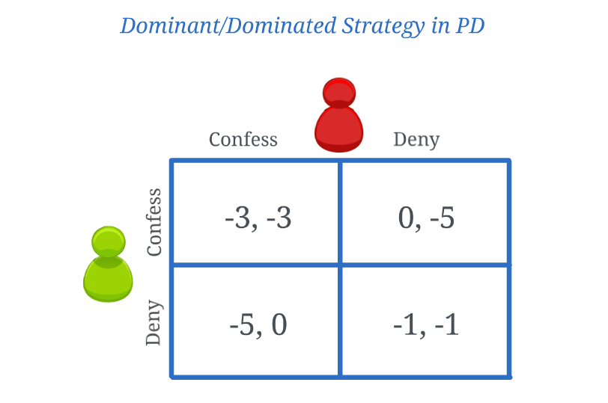
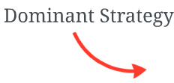
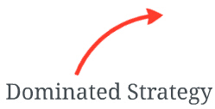
Dominant Strategy and Dominated Strategy

Slide 20
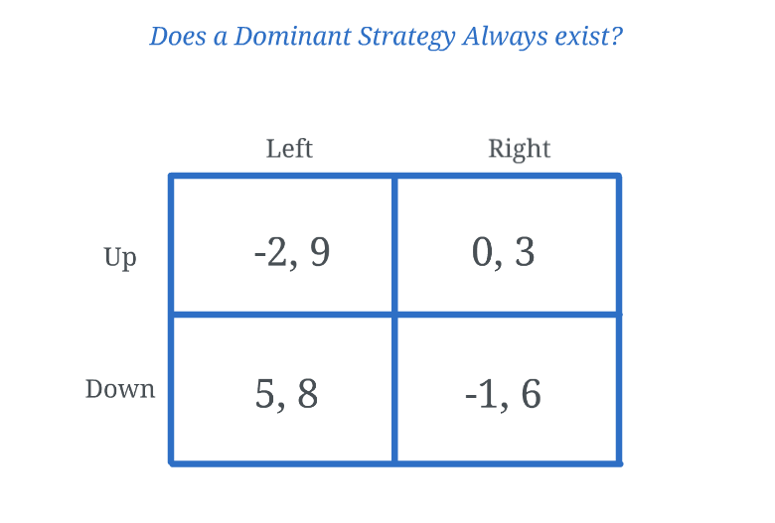
Dominant Strategy and Dominated Strategy
unsure!

Slide 21
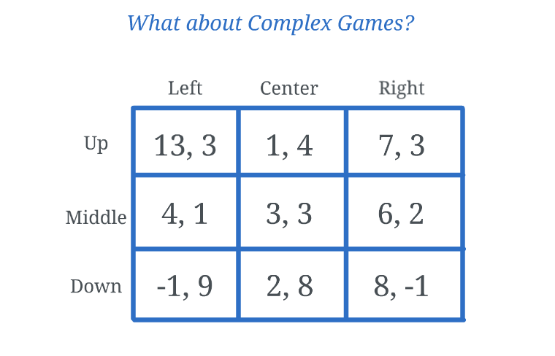
Dominant Strategy and Dominated Strategy

Slide 22
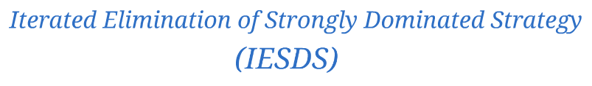
Dominant Strategy and Dominated Strategy
Iteratively delete a strongly dominated strategy until none exits.

Slide 23
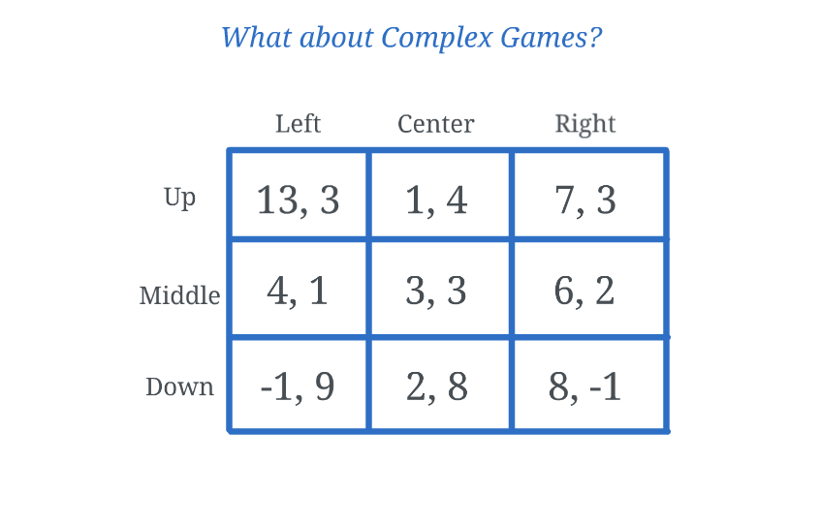
Dominant Strategy and Dominated Strategy

Slide 24
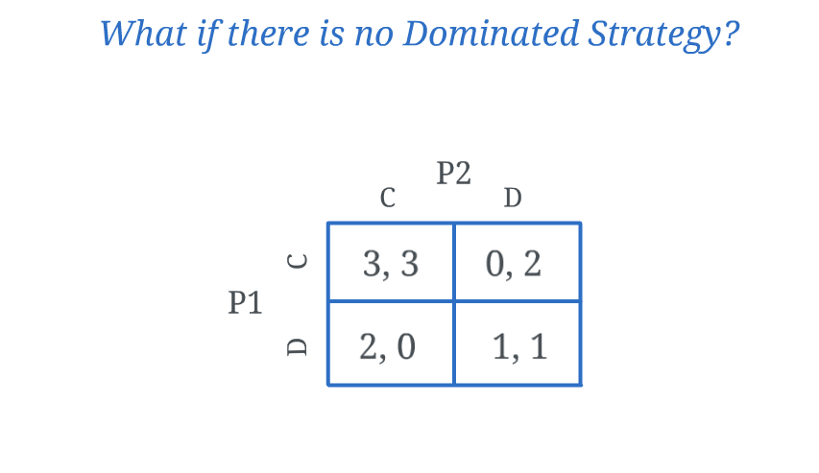
Nash Equilibrium

Slide 25

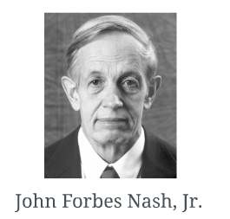

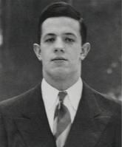
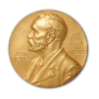

Nash Equilibrium
A set of strategies, one for each player, where no player can improve its payoff by unilaterally changing its strategy.

Slide 26
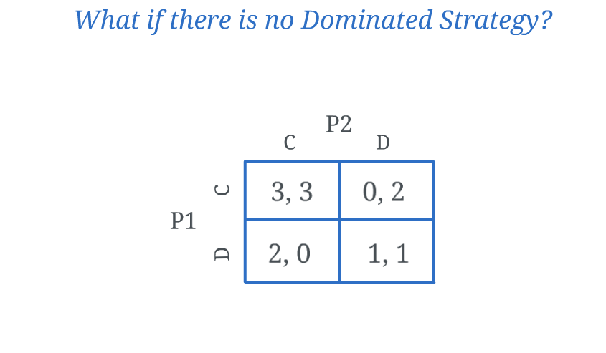
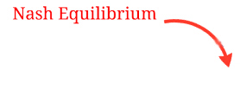
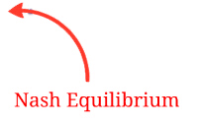
Nash Equilibrium

Slide 27
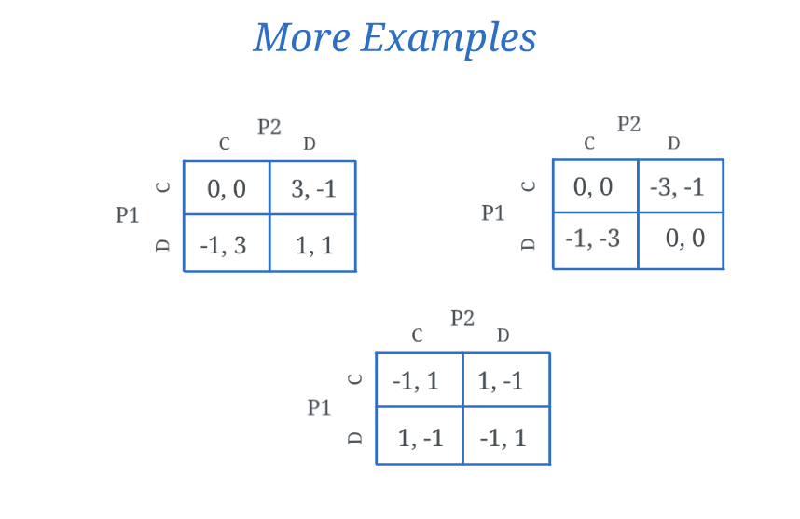
Nash Equilibrium
NE:(C,C)
NE:(C,C) and (D,D)
No NE

Slide 28
3. Auction

Slide 29
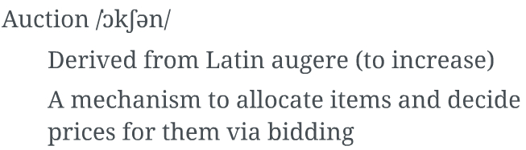

What is Auction?

Slide 30
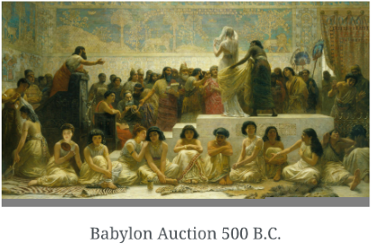
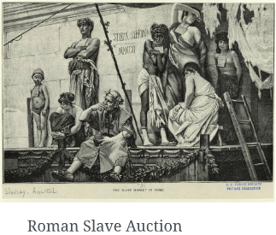
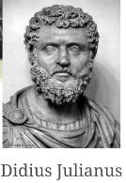
History of Auctions

Slide 31
Why Auctions?
What is the "right" price for the object?
How much are bidders willing to pay?
We can ask them... They will probably lie.

Slide 32


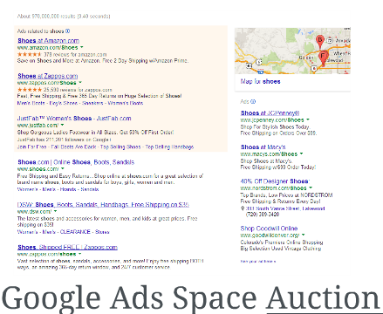
Examples of Auctions
FCC Spectrum Auction

Slide 33
Goals of Auctions
Reveal valuations of bidders
Discourage cheating and collusion
Maximize revenue
Maximize social welfare

Slide 34
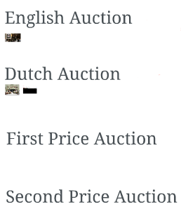


Common Auction Forms

Slide 35
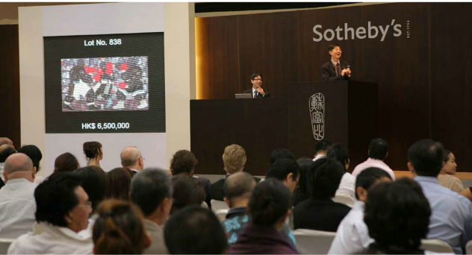

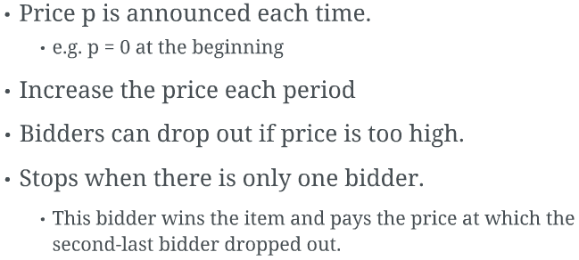
English Auction

Slide 36
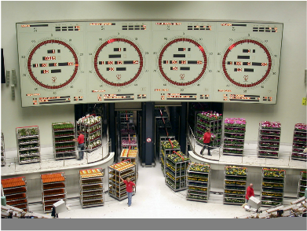
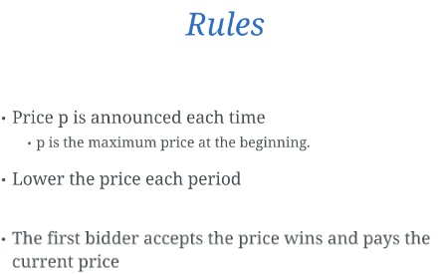
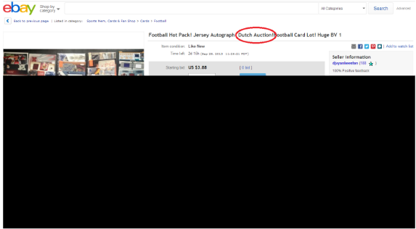
Dutch Auction

Slide 37




First Price Auction
Rules
Each bidder writes its bid in a sealed envelope.
The auctioneer collects bids.
Winner:bidder with the highest bid.
Payment:winner pays his bid.

Slide 38


Second Price Auction
Rules
Each bidder writes its bid in a sealed envelope.
The auctioneer collects bids.
Winner: bidder with the highest bid.
Payment: winner pays the second hightest bid.

Slide 39
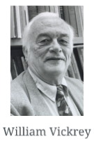
AKA Vickrey Auction
Auction defined by William Vickrey in 1961.
Won the Nobel prize in economics in 1996.
Died shortly before the ceremony...

Slide 40
Truthfulness

Slide 41
4. Three Topics in Network

Slide 42

Security & Privacy
Crowdsensing
Wireless Charging

Slide 43
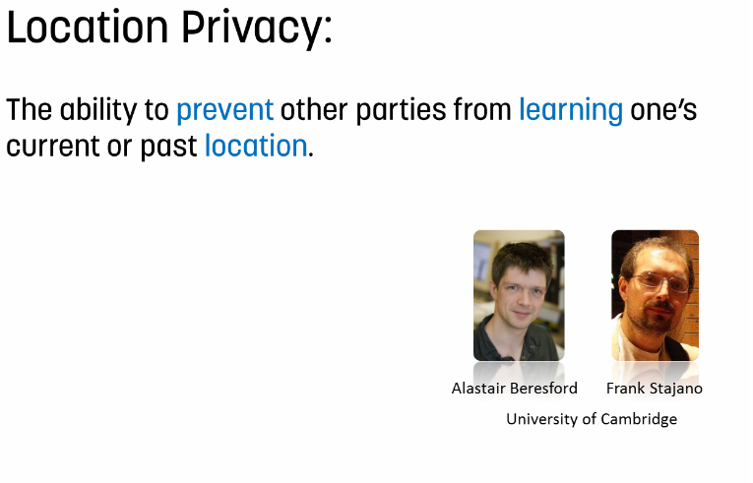
面向语义的短文本分类的研究

Slide 44
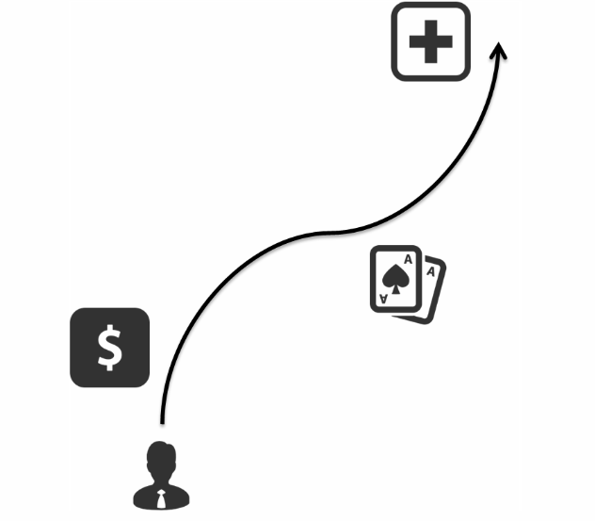

面向语义的短文本分类的研究

Slide 45
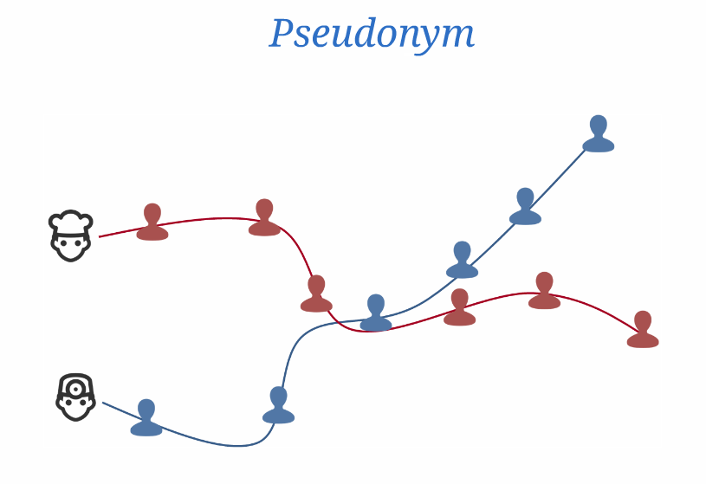


面向语义的短文本分类的研究

Slide 46
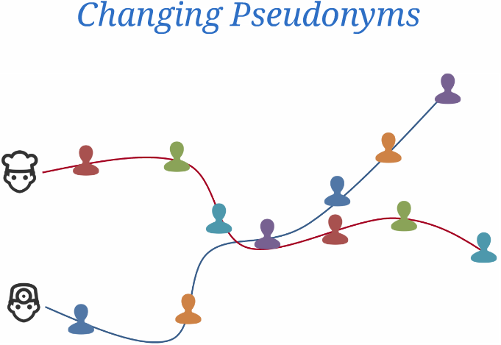
面向语义的短文本分类的研究

Slide 47
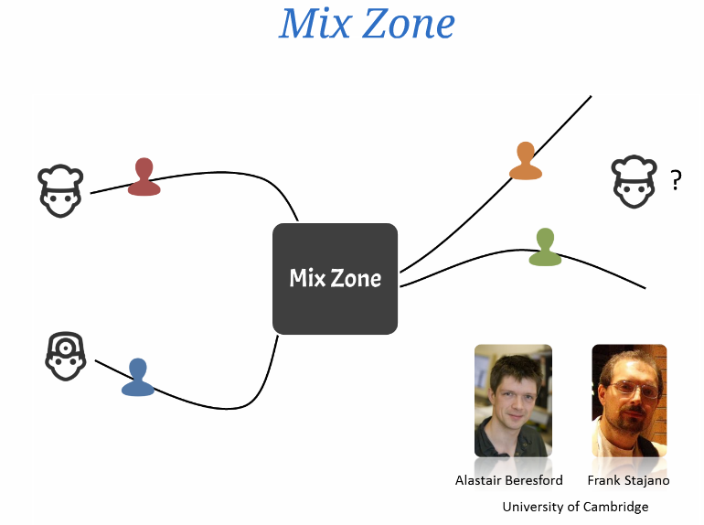
面向语义的短文本分类的研究

Slide 48
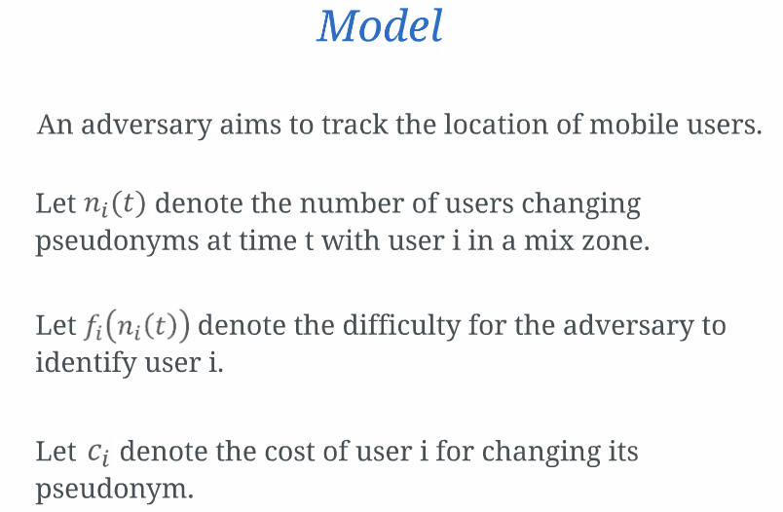
面向语义的短文本分类的研究

Slide 49
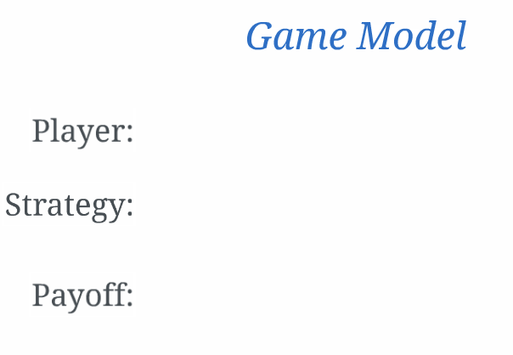


面向语义的短文本分类的研究

Slide 50

面向语义的短文本分类的研究

Slide 51
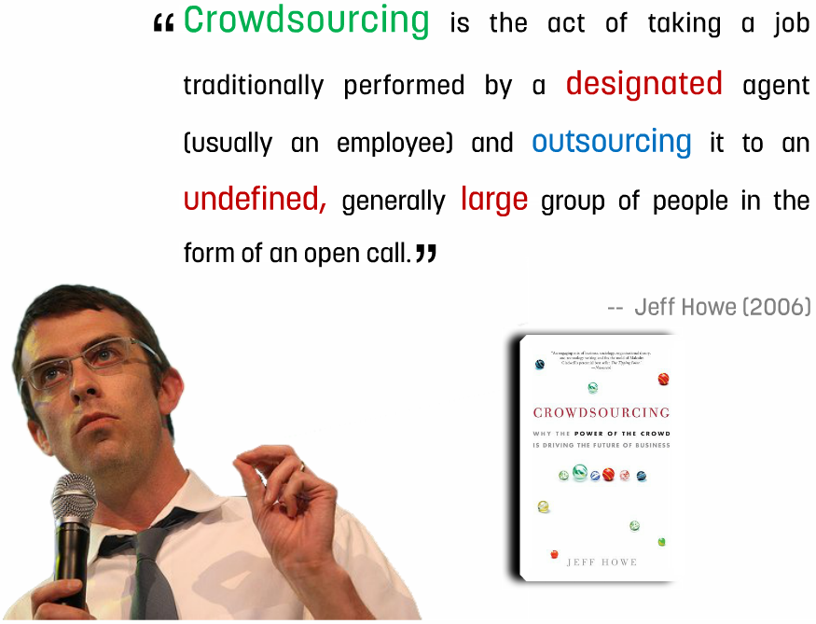
面向语义的短文本分类的研究

Slide 52

面向语义的短文本分类的研究

Slide 53
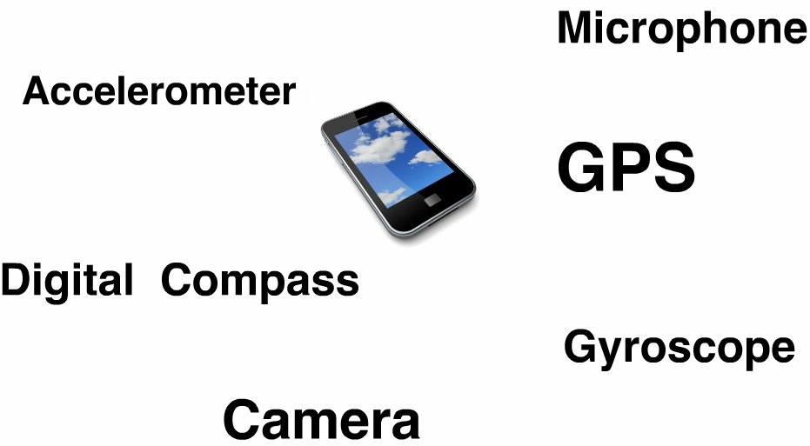
面向语义的短文本分类的研究

Slide 54
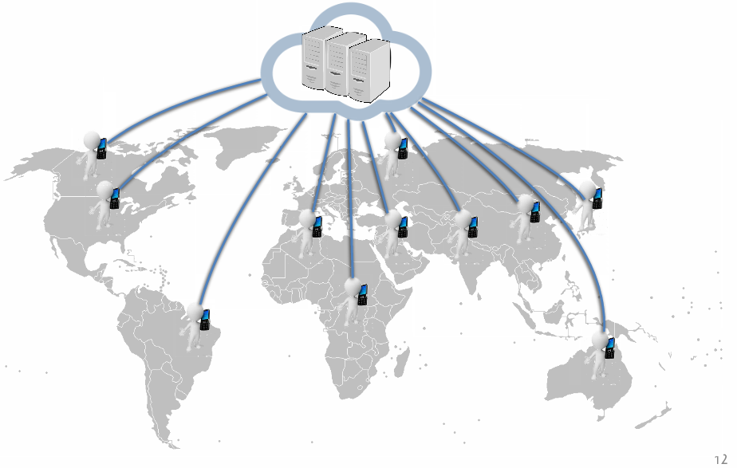
面向语义的短文本分类的研究

Slide 55

面向语义的短文本分类的研究

Slide 56

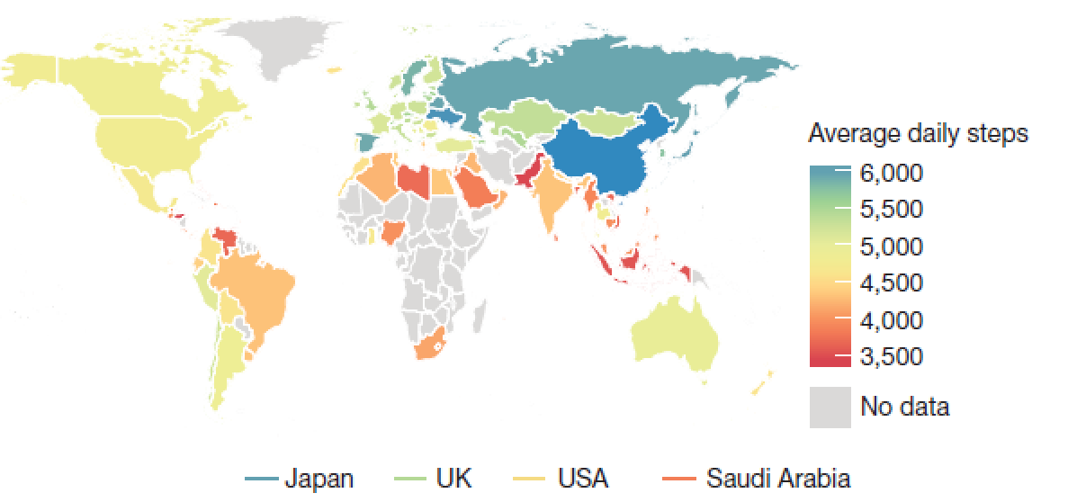
Global physical activity evaluation
Nature
Notes:
Consisting of 68 million days of physical activity for 717,527 people, giving us
a window into activity in 111 countries across the globe.
Argus smartphone application developed by Azumio.

Slide 57





More applications
City-wide air quality monitoring
Waze
Number recognition
Dining habit

Slide 58

面向语义的短文本分类的研究

Slide 59

面向语义的短文本分类的研究

Slide 60

面向语义的短文本分类的研究

Slide 61

Crowdsourcing with Biased Requesters
I intend to hire native Hungarian speakers to order Hungarian to English translations
I expect to assign the mobile crowdsensing tasks to the workers who are close by the specific locations
Preference over workers!
I wish to allocate the tasks to the people who are with high reputation

Slide 62
Crowdsourcing Process
each consists of a task and a preference set
preference set: a set of compatible workers
Designing truthful task assignment mechanisms to maximize the total value

Slide 63
Desired Properties & Challenges
Preference truthfulness
Notes:
consider not only the value of the allocation but also the compatibility of the allocation
strategic action by submitting a dishonest preference set to maximize his own value
The workers are associated with workload constraints, and the aggregate workload of the assigned tasks to each worker should be within its workload constraint

Slide 64
Generalize to the Non-identical Value Case
Objective Function:
Constraints:
(1)
(2)
(3)

Slide 65


It Looks So Easy?!
Requesters
Tasks
Workers
… …
Maximum Weighted Bipartite Matching

Slide 66
How About Hungarian Method ?
The VMA Problem in IN-Model
Maximum Weighted Bipartite Matching Problem
?
Hungarian Method

Slide 67
Check the Truthfulness of Hungarian Method
An Example
task
worker
Requester2 lies
Hungarian method is untruthful
Notes:
We now consider the case where requester 2 lies by submitting
Note that requester 2 increases its value from 1 to by lying about its preference set.

Slide 68


A Greedy Algorithm—TAM-IN
Input: Worker Set W, Request Set B,Effort Indicators I
1:Sort all pairs$(i,k)$, $i∈R$,$k∈P_{i}$based on $v_{i}^{k}$ in nonincreasing order and the sequence is denoted by $𝒥$;
Sort all pairs
2:$A←∅$;
3:for all $j∈𝒥$ in order do
4: if $A ∪ \{j\}$is a matching on $G(R,W,J)$ then
5: $A ← A ∪ \{j\}$;
6: end if
7:end for
8:return (A);
Select the pairs

Slide 69
Wireless Charging
面向语义的短文本分类的研究

Slide 70


System Model And Problem Formulation
1、无线充电器价格高昂
2、全向充电技术的开放性
3、作为基础设施
4、作为商业模式
5、适用性广
System Model
Notes:
We present a cooperative charging system in the environmental monitoring application scenario.
We consider a set of omnidirectional wireless chargers located at fixed positions in a 2D plane. These wireless chargers are operated by different CSPs and may have different charging prices. The rechargeable devices can move from the initial locations to the corresponding chargers to obtain the charging service. The comprehensive cost of any device is the sum of charging cost (payment to the charger) and the round-trip moving cost between the initial location and the charging position. The devices assigned to the same charger form a charging group, in which the devices can obtain the surplus by sharing the charging cost in the common charging hours.

Slide 71




System Model And Problem Formulation
  Cooperative Charging Model
(1) The moving distance of device:
(2) The moving cost of group :
(3) The charging cost of group :
(4)The comprehensive cost of group :
Notes:
(2) To keep working (e.g., sensing tasks), the devices must return to the initial locations after their energy are replenished.
(3) Max E/Pr(s,o) represents the maximum charging time of devices in group coj .
(4) Comprehensive cost is the sum of moving cost and charging cost

Slide 72

System Model And Problem Formulation
Problem Formulation
The problem is to schedule the mobile rechargeable devices to the chargers with objective of minimizing the total comprehensive cost of all charging groups such that each device is assigned to exactly one charger.
Notes:
Constraint 1 ensures that all rechargeable devices should be charged.
Constraint 2 ensures that each rechargeable device can be scheduled to exact one charger.
建议补充:
In view of the commercial feasibility of charging economy, we consider that each mobile rechargeable device only can obtain the charging service from one charger every time.

Slide 73
CCS As a Cooperative Game
CCSA still incurs high computing cost and is inefficient for the large-scale WRSNs.
We formulate the CCS problem as a coalition formation game, termed CCS Game, which can improve the solution gradually.
CCS Game
the strategy profile of all rechargeable devices
the coalition structure without overlap
the comprehensive cost of any device in coalition

Slide 74


CCS As a Cooperative Game
Coalition Order
设备偏好于加入引起最小综合成本增加的联盟
Utility Function
由于该设备的加入导致的综合成本变化
Notes:
Coalition order补充：This coalition order means that the device prefers the coalition with the minimum increase of comprehensive cost. This preference order cares about the comprehensive cost of whole coalition partition.
Utility function补充：The utility represents the change of comprehensive cost of all rechargeable devices in the coalition cozi due to the join of rechargeable device oi.

Slide 75

CCS As a Cooperative Game
Algorithm Design--CCSGA
Notes:
At each round of iterations, each device chooses a charging group to maximize its utility, and the device leaves the current charging group and joins to the selected charging group. Repeat this process until no rechargeable device can improve the utility by changing the coalition selection unilaterally

Slide 76
CCS As a Cooperative Game
Theoretical Analysis of CCSGA
Theorem 5. CCS Game has at least one Nash Equilibrium, and CCSGA finally converges to a Nash-stable Coalition Structure.

Slide 77

Thank You!

